Slide 1
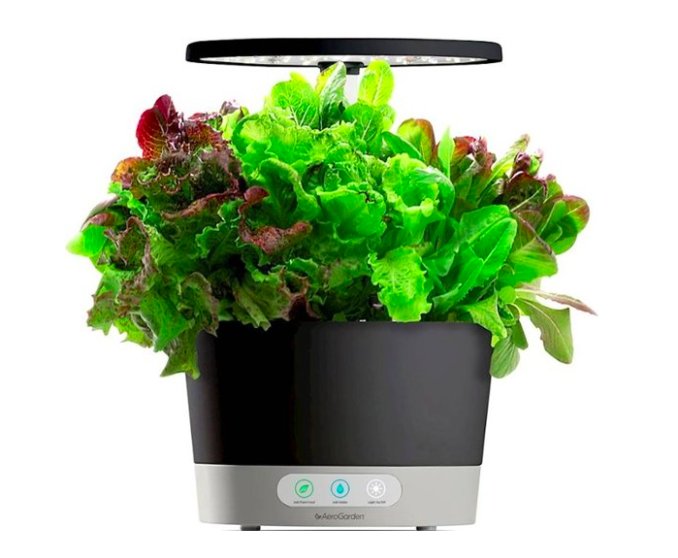
Smart Garden
Team Members
Jean Louis, Computer Science PhD Student
Abhishek Jha, ECE Masters IInd Year
Sathvik Udupa, ECE Masters IInd Year
John Harris, Chair

Slide 2
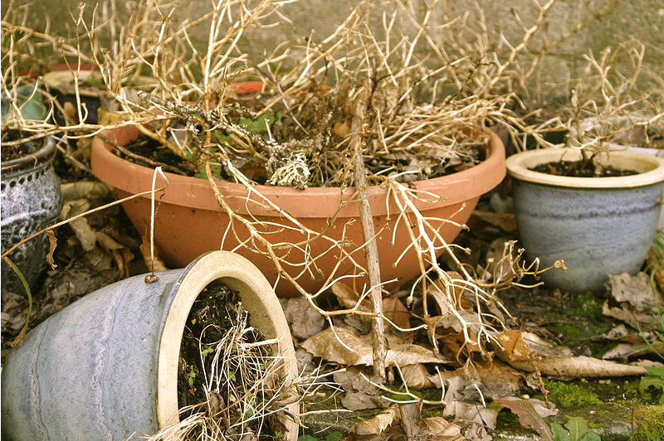
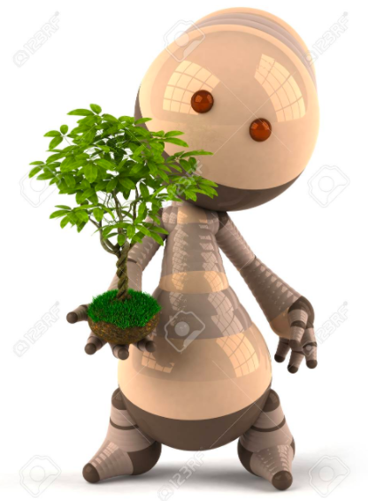
Project Motivation
You're killing your plants !!
Taking care of garden is difficult for people with busy schedules, those who constantly travel, negligence
Create a system to take care of plant environment and constantly monitor it
Smart Garden will monitor environment and soil conditions for the benefit of your plant
Automate water supply, monitor lighting and can also provide surveillance around it
Alert the owner of possible hazards associated around the plant

Slide 3
IoT Design Methodology: Purpose and Requirements
Purpose : An autonomous sensor network capable of monitoring plant environment.
Behavior : Monitor critical parameters and automate water/light supply based on the parameters
System Management Requirement : Periodically capture the critical parameters, establish a link to the cloud, saving data for each different sensor network
Data Analysis Requirement : Use the in-house API's from our cloud server Firebase, to create visualizations and apply Machine Learning models to better influence plant growth
Application Deployment Requirement : Webservice to be hosted on the sensor node to interact with cloud APIs to periodically store data, a user interface for the user to override water supply or light supply

Slide 4
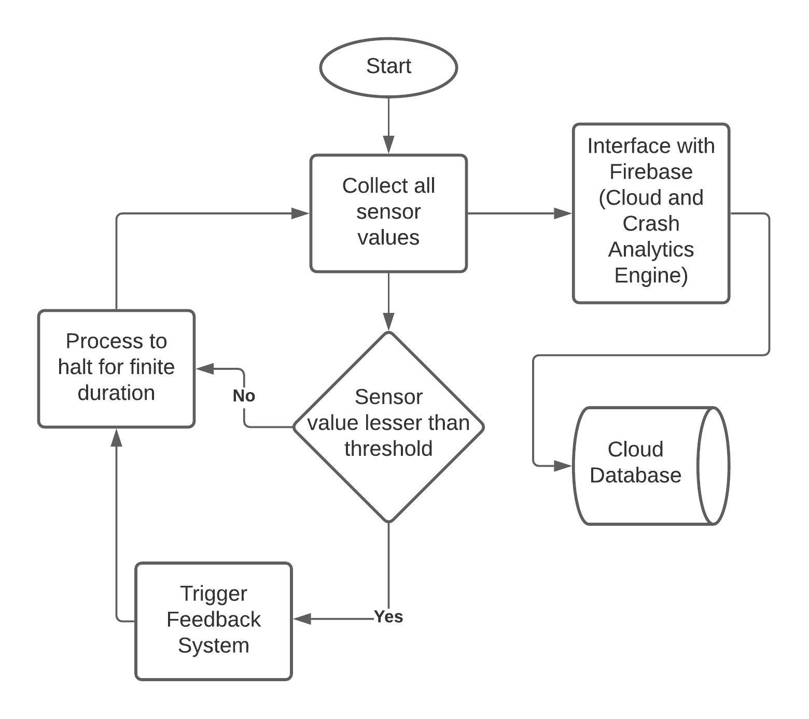
IoT Design Methodology: Process Specification

Slide 5
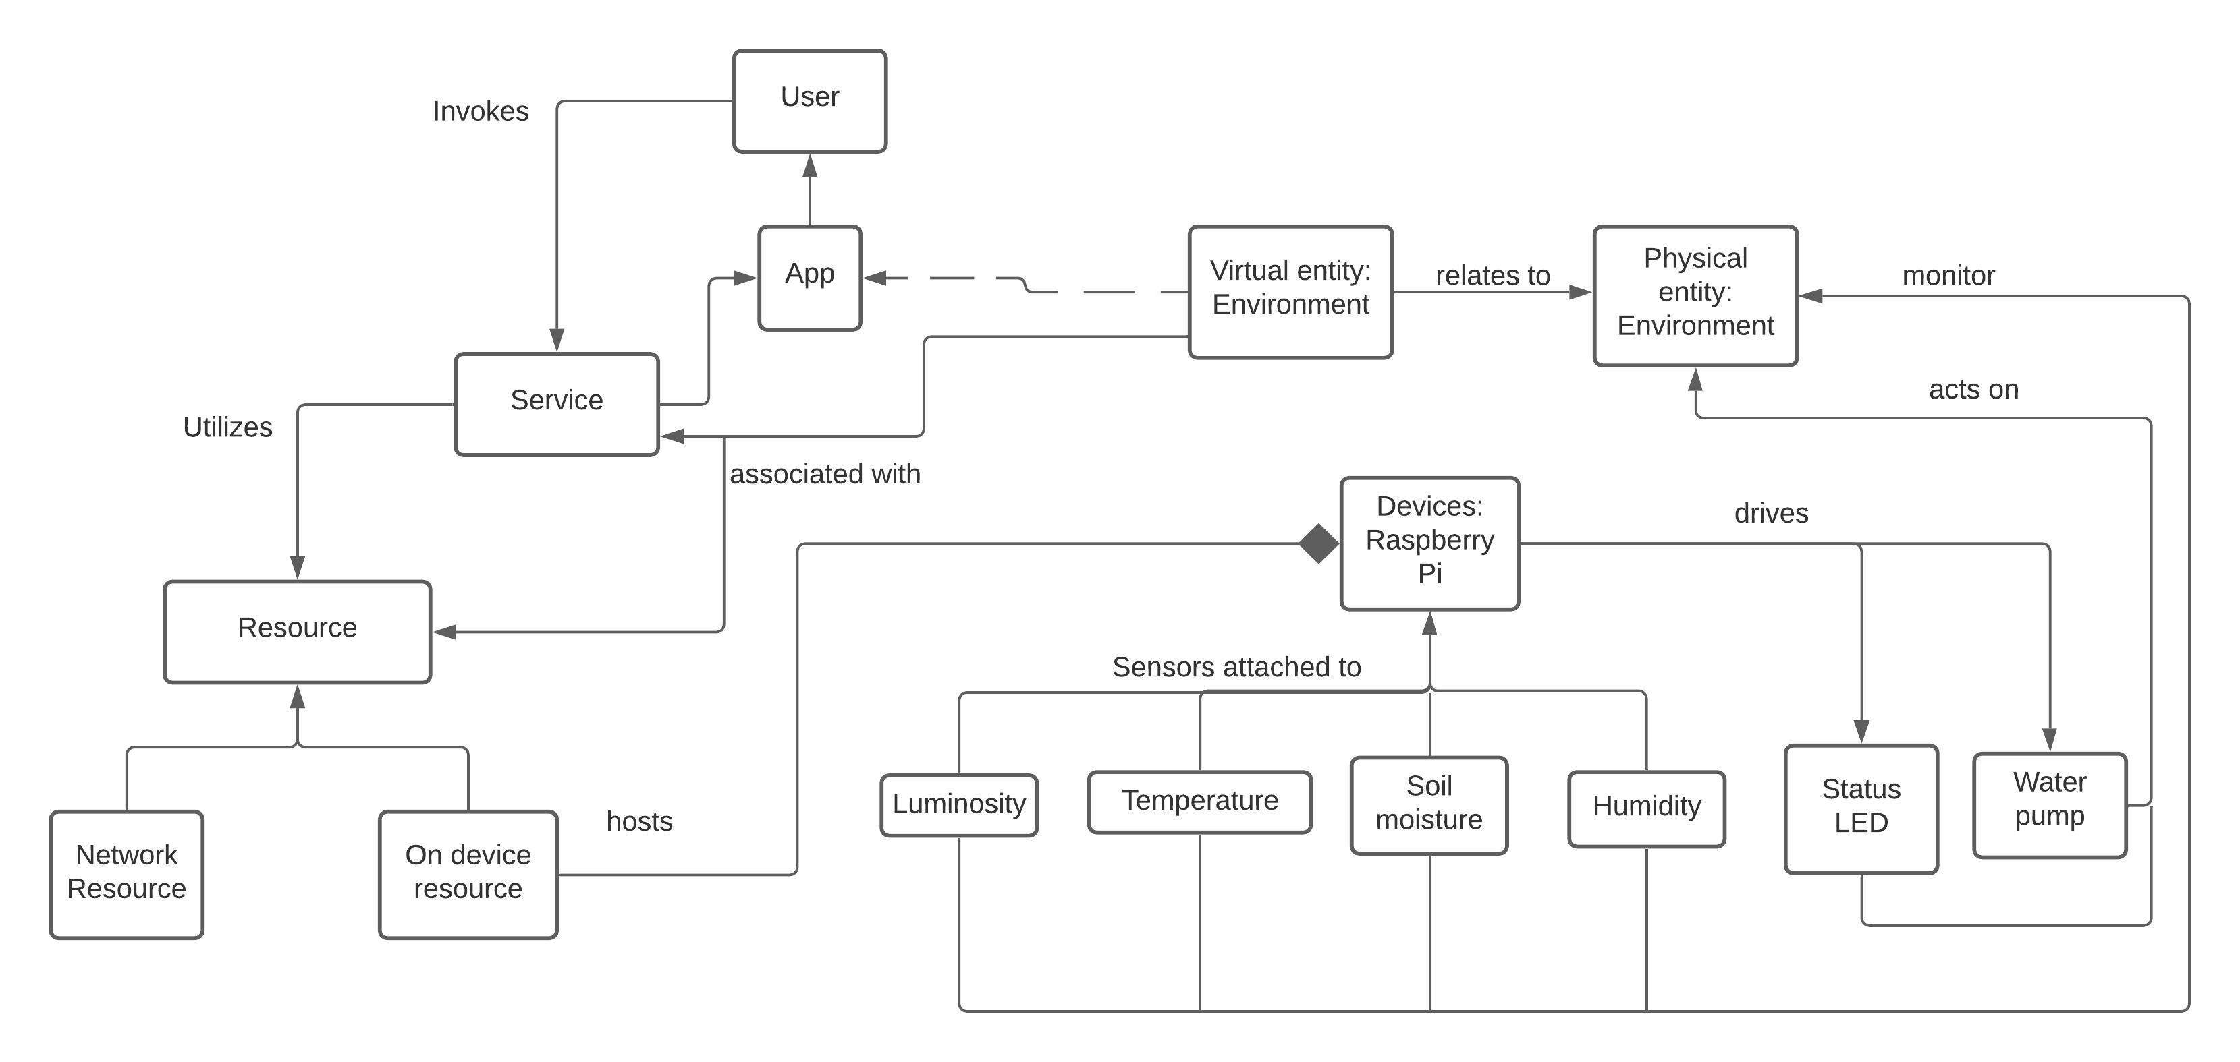
IoT Design Methodology: Domain Model

Slide 6
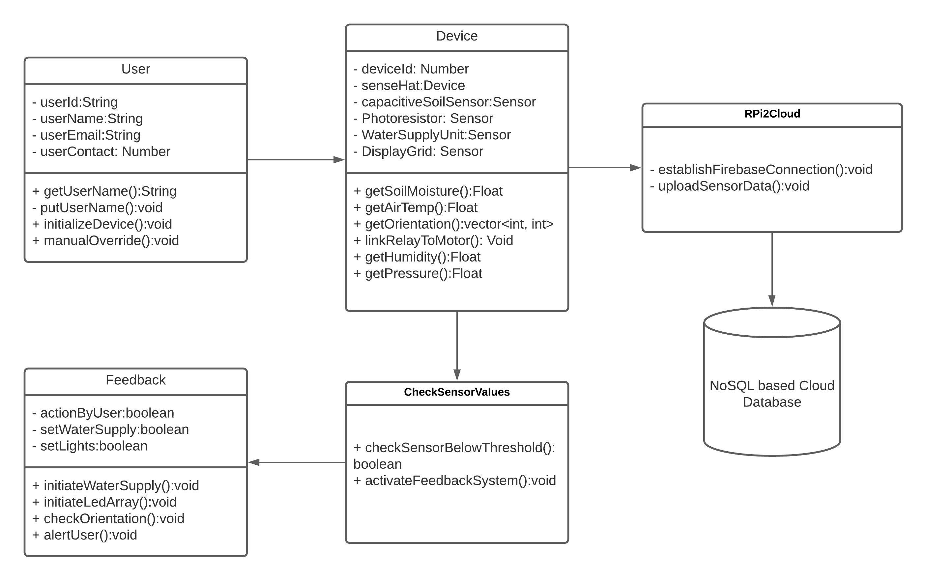
IoT Design Methodology: Information Model

Slide 7
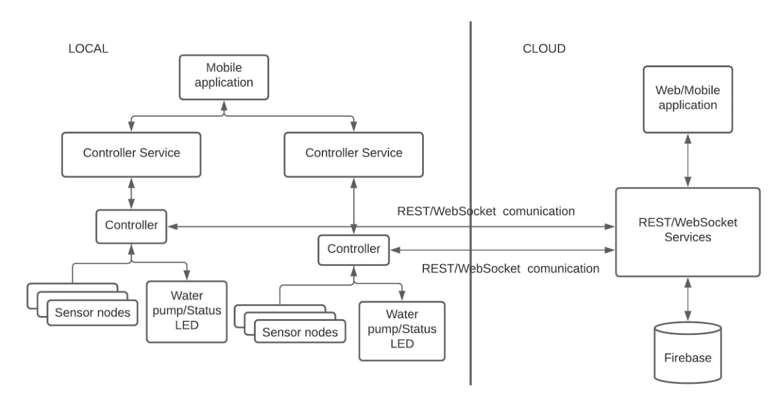
IoT Design Methodology: IoT Level Specification – Level 6 Architecture

Slide 8
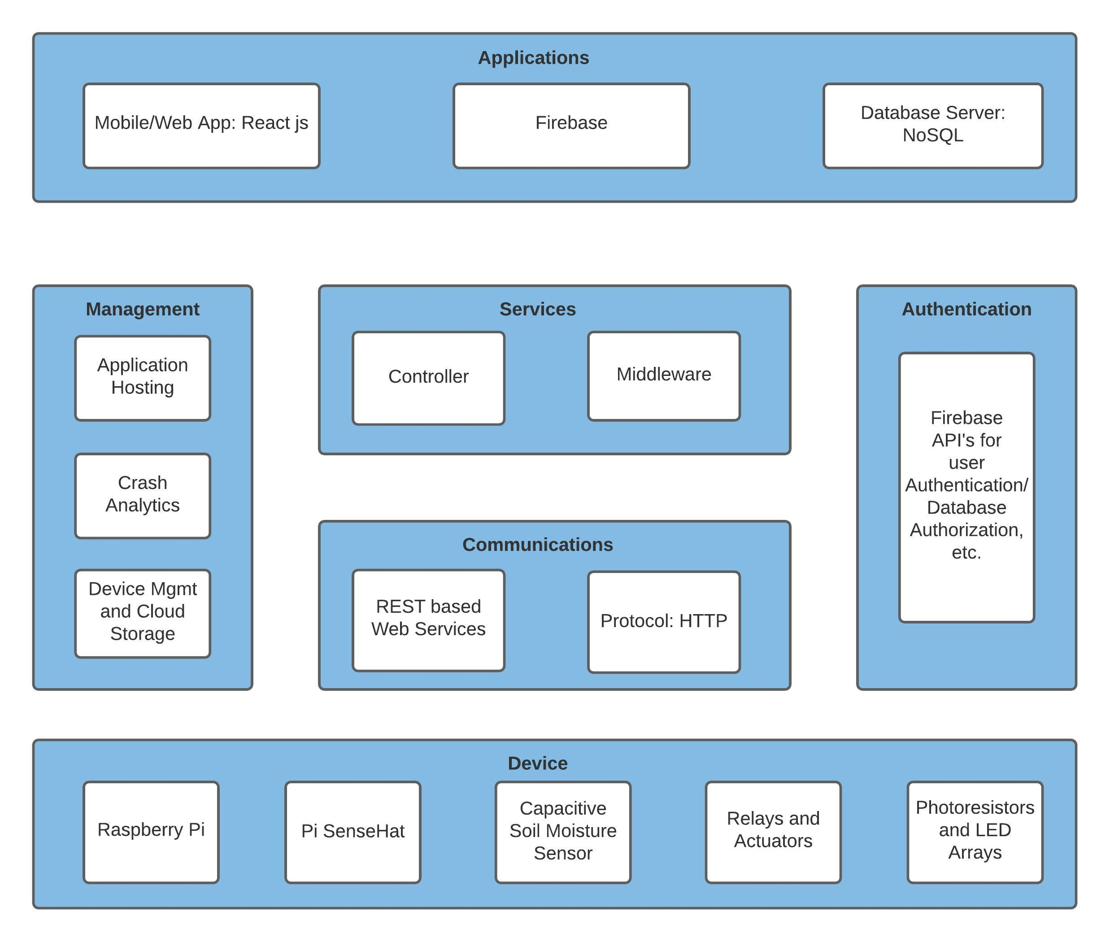
Functional View

Slide 9
Requirements for this semester
System Must..
Monitor Soil and Environment Parameters around the plant
Provide services to allow automated water supply, lighting.
Hazard Detection
Establish link to cloud and periodically capture information for every node.
Sensors to be powered by the Raspberry Pi and Raspberry Pi Sensehat

Slide 10
Approach and Schedule: Key Milestones
Now – Oct 21
Purchase Hardware, Complete Sensor to Controller Communication
Oct 22– Nov 7
Create web services and interfaces to realize the motivation, connect to cloud database
Nov 8 – Nov 22
Test Integration between different systems and debug critical issues
Nov 23 – Nov 30
Complete report and provide visualizations from the collected data

Slide 11
Thank You Questions??

